Slide 1
TDR
Motor + Reducer

Slide 2
1 - Input
We want our robot to have following characteristics (see SRS R1) :
Max speed >= 0,5 m/s
Acceleration >= 0,5 m/s²
Most importantly, we want our robot to be precise, especially at low speed.

Slide 3
1 - Input
Constraints
The dimensions of the robot are limited by the rules.
On our robot, we want to align on the same axis two motor wheels and two rotary encoders. That’s the reason why, if the motors are too long, we will have to rotate them by 90° and to use two bevel gears.

Slide 4
2 - Analysis
Dimensioning the motor for acceleration:
Let P be the power of a single motor, and m the mass of the robot:
The acceleration of the robot is 2 * a / m (because there are two motors).
In our case, we want the acceleration to be >= 0,5 m/s while accelerating, and as big as possible while braking.
However the power of the motor is limited by the battery, and particularly by its capacity. For practical reasons, we want our motors to be powered by a 12V voltage. We chose a power of 14W per motor. The amperage required for the motors will then be 14*2 / 12 = 2,3 A, which is reasonable.
Notes:
>> The acceleration of the robot is 2 * a / m
En quelle unité ???
De façon générale, calcul pas clair, je n’ai notamment pas vu la masse du robot …

Slide 5
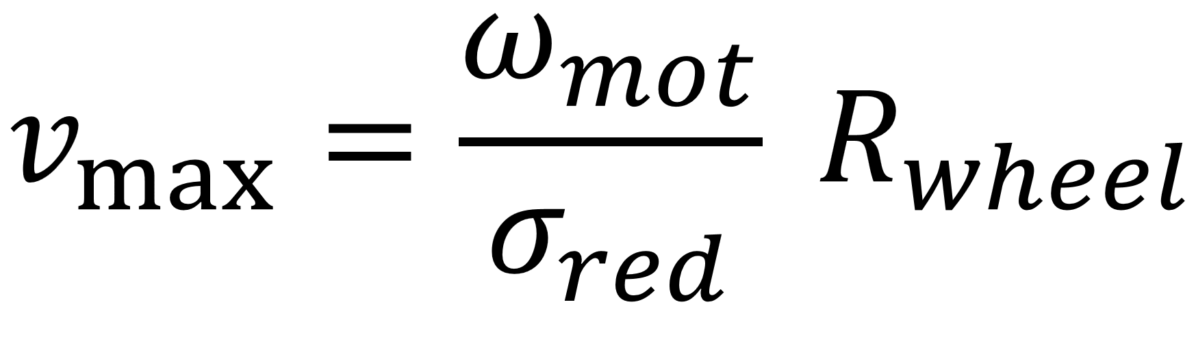
2 - Analysis
Dimensioning the max speed of the robot
We want this max speed to be >= 0,5 m/s.
The max speed is given by:

Slide 6
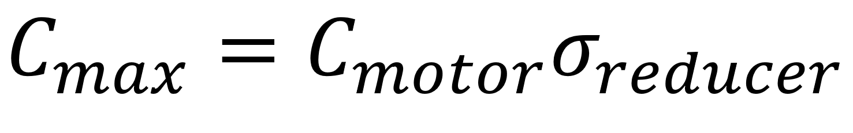
2 - Analysis
Dimensioning the torque of the motor
The torque is the quantity that we want to maximise.
A great torque will allow our robot to perform precise moves even when moving slowly.
The torque after the reducer is given by:

Slide 7
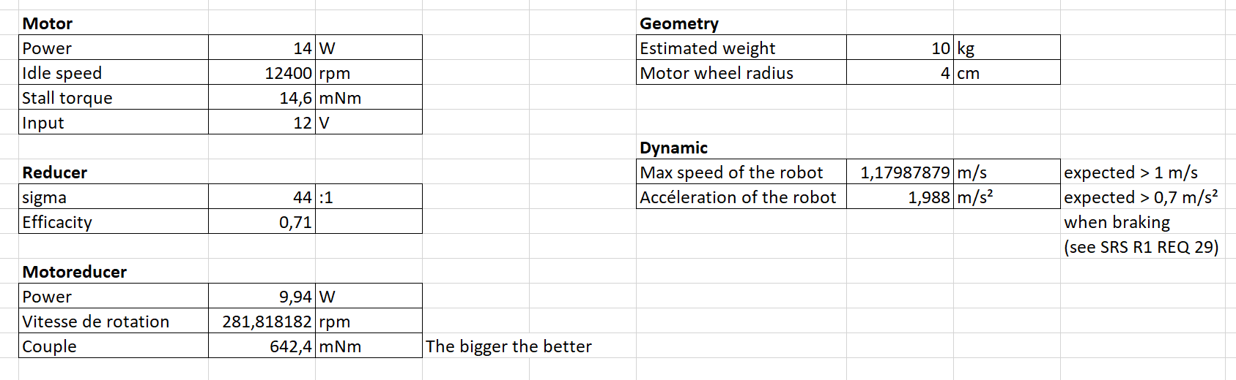
3 - Choice of the motoreducer
The website Maxon allows us to choose between differents great quality and compatible materials and thus choosing a perfectly adequate couple motor/reducer. The best compromise (understood with the previous analysis) we found is the following :
Désolé les gars je peux pas vérifier vos calculs sans la feuille excel
Je l’ai refaite.
Vous etes sur que vous vous etes pas trompé en prenant l’idle speed ?

Slide 8
4 - Conclusion
We chose the Maxon DCX 22 S Ø22 mm, Graphite Brushes, ball bearings equipped with the Planetary gearhead GPX 22 C Ø22 mm, 2-stage
Maxon motors are very high quality and reliable material.
This motoreducer is the best choice maximising torque, keeping speed above requested and working on 12V.
Being also quite powerful (14W) it might require a lot of current and thus a powerful battery.
Votre batterie arrivera toujours à sortir l’ampérage. (si lithium). Ca va être sa capacité la question

